Slide 1
Software QA and Testing with Automation using Selenium IDE Course 1, Class 4
Instructor
David F Wagoner
PMP, CSQE, CMQ/OE

Slide 2
Site Security
Unfortunately, we have among us some who are motivated by hacking and care little for our lost time, money and data
Hacking has gone from nerds in basements to villains that rake in millions and billions of dollars – it’s their profession
At the end of the day, it’s usually someone that, pardon the pun, couldn’t hack it in the real world, so they seek prestige in an underworld to prop up sagging egos

Slide 3
Site Security (cont.)
There are many aspects to security and security testing that are well outside the testing domain you will occupy
Making the system secure is NOT your job. That belongs to:
Security personnel
Project managers
Company managers
Developers

Slide 4
Security Testing
There are two approaches involved in security testing:
Scan and penetration testing, which involves
Scanning developer code for patterns that promote weakness or allow weakness and vulnerabilities to exist at the code level
Usually scanned as a release is promoted to systems testing and again before final release
Scanning systems to detect common vulnerabilities at the system and system resource levels. That is having the right firewalls and control over the allocation of ports and other matters well beyond the scope of this course
There is an initial scan then ongoing scans, usually nightly
This approach is very rigorous in federal systems and less so in commercial systems

Slide 5
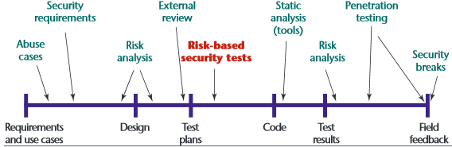
Security Testing
It’s important to understand the role and placement of security testing in the SDLC

Slide 6
Security Testing
Your focus, if any on security testing will be from a functional view
It boils down to – Can I get to what I’m supposed to and ONLY what’s I’m supposed to?
Can you login in or access any part of the system that you shouldn’t?
Is there a use privilege aspect to the system?
Even the simplest customer-based web site has user privilege access
Because testers are non-technical and penetration schemes are increasingly technical and complex, most QA shops are constrained in what they do for security testing
However, security testing is a wonderful candidate for automation

Slide 7
Security Testing
There are aspects of security testing that the functional test can be involved in:
Security requirements definition
Identity management
Authentication
Input overflow for injections
SSL certificate management
For more information, refer to the Open Web Application Security Project (OWASP)
https://www.owasp.org/index.php/Category:OWASP_Testing_Project

Slide 8
A Note
There are a couple things to note regarding the textbook
Chapter 17 identifies test design, which is a valid activity especially for mission or life-critical systems
In reality, it is rarely part of a testing effort, except for Test Data Design

Slide 9
Selenese
Three types of commands
Actions
These do something to the application in the browser to perform an action inside the browser
Failure to perform an action causes script failure and halt
Accessors
Allow you to access the state of the application and store that information in a variable
Assertions
Verifies the state of the application or object is what is expected
Three types of assertions
Assert, verify, waitfor

Slide 10
Selenese
Assertions
Assert
Looks at an object (page, page element, internal variable) and determines whether a condition exists
Does the title, a link, an object have specific text or values?
If not, the test fails and halts
Verify
Same as assert but when it fails, an error is logged and script execution continues
Waitfor
Waits for a condition to be true
If the condition is false and the timeout setting is exceeded, the script will fail and halt
When to use assert instead of verify

Slide 11
Selenese
Script syntax
There are three elements, a command and two optional parameters
Commands
Verify text, assert something or put something
Parameters
Whether either parameter is necessary is determined by the command
Locate some thing on a page
Text or state information for assert or verify
Text or state information to put
Recall that all of this is stored as a 3 column html table
Command, Parameter 1, Parameter 2

Slide 12
Selenese
Common Selenese commands
open
opens a page using a URL.
click/clickAndWait
performs a click operation, and optionally waits for a new page to load.
verifyTitle/assertTitle
verifies an expected page title
verifyTextPresent
verifies expected text is somewhere on the page
verifyElementPresent
verifies an expected UI element, as defined by its HTML tag, is present on the page
verifyText
verifies expected text and its corresponding HTML tag are present on the page
verifyTable
verifies a table’s expected contents
waitForPageToLoad
pauses execution until an expected new page loads. Called automatically when clickAndWait is used
waitForElementPresent
pauses execution until an expected UI element, as defined by its HTML tag, is present on the page

Slide 13
Selenese
Locating UI elements
Use Id and name instead of xpath
Xpath is used to locate items not explicitly named or identified and is beyond the scope of the course by:
Relative reference to a named or identified object
Absolute reference (not recommended)
Fails easily when developers move stuff around
CSS and DOM

Slide 14
Selenese
Pattern Matching (globbing)
Often useful to look for something based on a partial text match
Wildcard ‘*’
Identifies variable parts of text along with fixed parts
Dan* will find Dan, Dance and Dancing
Dan*g will only find Dancing
Brackets []
Locate any character in text that is within the brackets
[an] will find Dan, Dance and Dancing
[e] will find Dance

Slide 15
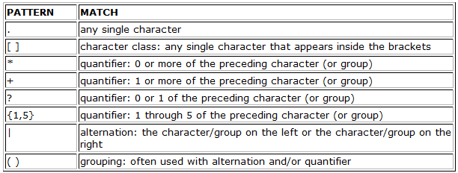
Selenese
Regular expression pattern matching
Prefixed by regexp: or regexp1:

Slide 16
Selenese
Using Variables
Names are alpha-numeric
The store command places the value of something, or a literal, into a variable
To access the value in a variable enclose the variable name in brackets and precede it with a $

Slide 17
Lab
Test Data Design using MS Access
Work on projects
Final Day
Demo your automation
Discuss employment in software/web testing

